Slide 1
IBM Platform Symphony MapReduce
Scott Campbell
Director, Product Management

Slide 2

Platform Computing, an IBM Company
Platform
Clusters, Grids, Clouds
Computing
The leader in managing large scale shared environments
  19 years of profitable growth
  9 of the Global 10 largest companies
  2,500 of the world’s most demanding client organizations
  6,000,000 CPUs under management
  Headquarters in Toronto, Canada
  500+ professionals working across 13 global centers
  World Class Global Support
  Strong Partnerships with Dell, Intel, Microsoft, Red Hat and VMWare

Slide 3
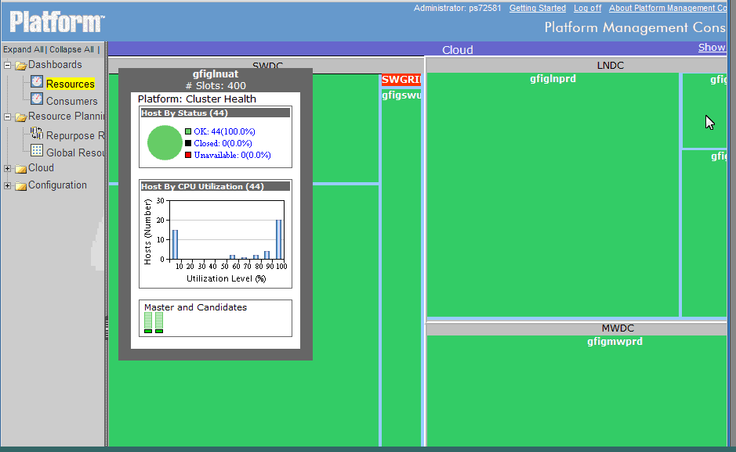
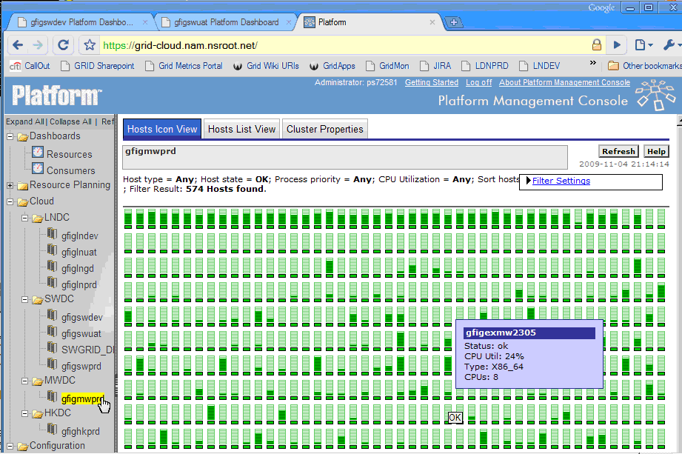
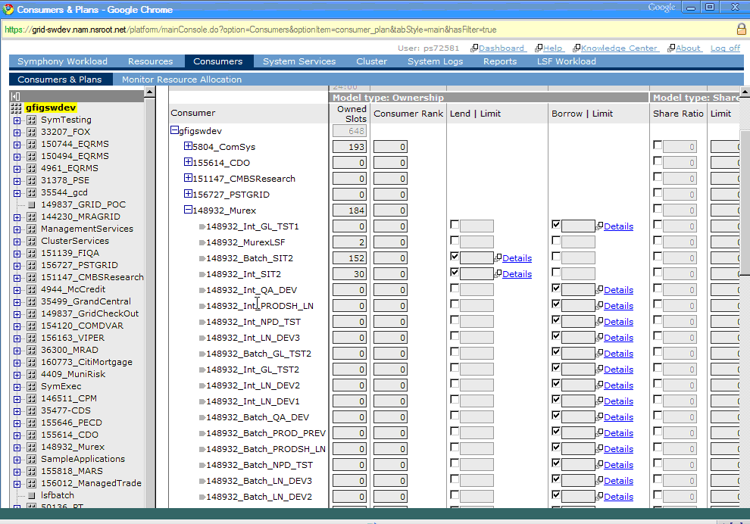
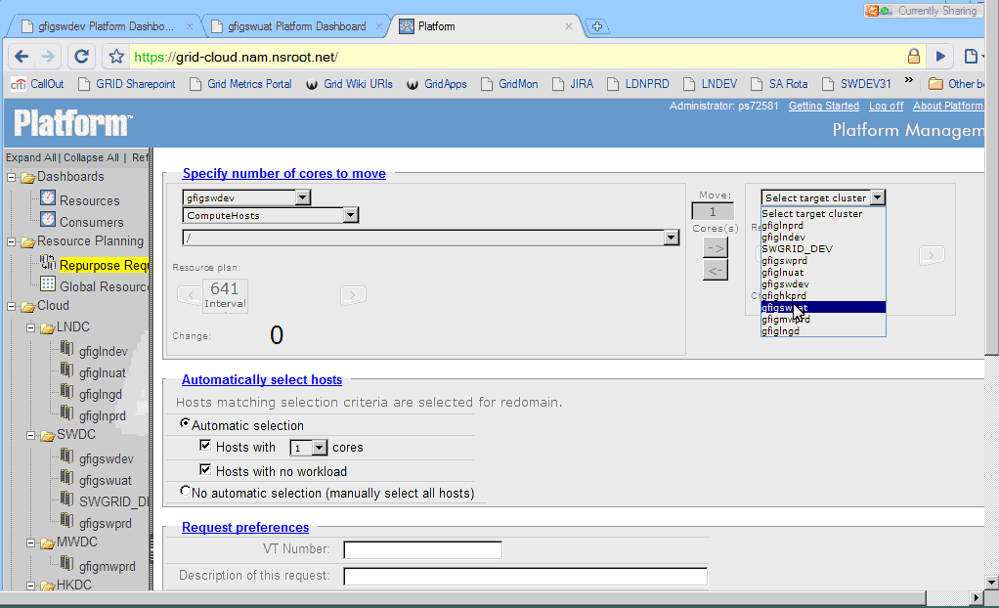
PLATFORM COMPUTING – Best-in-class Grid Computing Solutions for Financial Services
#2: SHARED GRID FOR ANALYTICS - CUSTOMER EXAMPLE
Technical Compute & Data Grid for Risk Analytics
Over 200 different IB & retail analytic applications on a shared infrastructure
Dynamic grid of 40,000 cores with over 70% sustained global utilization
Extreme management efficiency – Administrator to host ratio of 1:400
Task throughput – 400,000,000 tasks / day
14 different line of business sharing the global HPC infrastructure
Guaranteed SLAs for each business unit, extensive resource sharing
4 Data Centers with heterogeneous Linux & Windows hosts, two locations in the U.S., London and Hong Kong.
Home grown risk, pricing apps, and commercial apps including SAS, Murex etc.
Heterogeneous workloads (Batch, SOA, plans to deploy Map Reduce)
Self service, reporting and chargeback
Single global view of resource sharing among LOBS & applications across al geographies
Real-time monitoring & management of hosts: complete visibility to all global assets
Global resource plan for risk and associated applications enterprise-wide
Flexible resource allocations for LOBs & applications by data center & functional domain

Slide 4




IBM Platform Symphony
Compute and data intensive workloads
Compute intensive applications
Data intensive applications
A
B
Platform Symphony Workload Manager
A
A
A
A
A
A
A
A
A
A
A
A
A
A
A
A
A
A
B
B
B
B
B
B
A
A
A
A
A
A
B
B
B
B
B
B
B
B
B
B
B
B
B
B
B
B
B
B
Resource Orchestrator

Slide 5
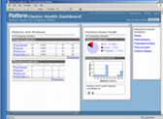
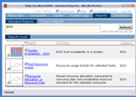
Platform Symphony
Architecture
Platform Management Console
COMPUTE INTENSIVE
DATA INTENSIVE
Platform Enterprise Reporting Framework
Low-latency Service-oriented Application Middleware
Enhanced Hadoop MapReduce Processing Framework
Service Instance Manager (SIM)
Platform Symphony Core
Resource Orchestrator

Slide 6
Application & Data Integration
Architecture
Application Development / End User Access
Hadoop Applications
Technical Computing Applications
MR Java
Pig
Hive
Jaql
MR Apps
R, C/C++, Python, Java, Binaries
Other
Hadoop MapReduce Processing Framework
SOA Framework
Distributed Runtime Scheduling Engine - Platform Symphony
Mgmt Console (GUI)
Platform Resource Orchestrator
File System / Data Store Connectors
(Distributed parallel fault-tolerant file systems / Relational & MPP Databases)
HDFS
HBase
Distributed File Systems
Scale Out File Systems
Relational Database
MPP
Database
Notes:
6

Slide 7



Platform Symphony MapReduce
Application Support
Application API
Application Managers
Platform Symphony
Application Managers
Application Managers
Application Managers
Map Task
Map Task
Map Task(s)
Reduce Task(s)
Split data and allocate
resources for applications
Local
Storage
Grid Orchestration
Input Folder
Output folder
Pluggable Distributed
File System / Storage

Slide 8
Job Execution + Monitoring
Execution Details
Distributed File System

Slide 9
Job Execution
Compatibility Example
d
Job submission command line:
  Apache Hadoop:
./hadoop jar hadoop-0.20.2-examples.jar org.apache.hadoop.examples.WordCount /input /output
  Platform M/R:
./mrsh jar hadoop-0.20.2-examples.jar org.apache.hadoop.examples.WordCount
hdfs://namenode:9000/input hdfs://namenode:9000/output
c
d
a
e
f
b
c
e
f
a
b
mrsh additional option examples
-Dmapreduce.application.name=MyMRapp
-Dmapreduce.job.priority.num=3500
  Submission script
  Sub-command
  Jar File
  Additional Options
  Input directory
  Output directory

Slide 10
Sophisticated Scheduling Engine
Fair Share Proportional Scheduling
  10,000 Level of Prioritization
Priority Based Scheduling
  Higher priority consumes all resources
Pre-emptive Scheduling
  Interruptive or non-interruptive
Threshold Based Scheduling
  Resources dynamically monitored
  Dynamic Open/Close Logic
  Administrator sets limits
Task Reclaim Logic
  Automatic when resources fail or ‘hang’
Resource Draining
  Maintenance mode
Administrative Control of Running Jobs
  Suspend, Resume, Change Priority, Kill Jobs/Tasks, Monitor
Application Managers
Application Managers
Application Managers
Application Managers

Slide 11
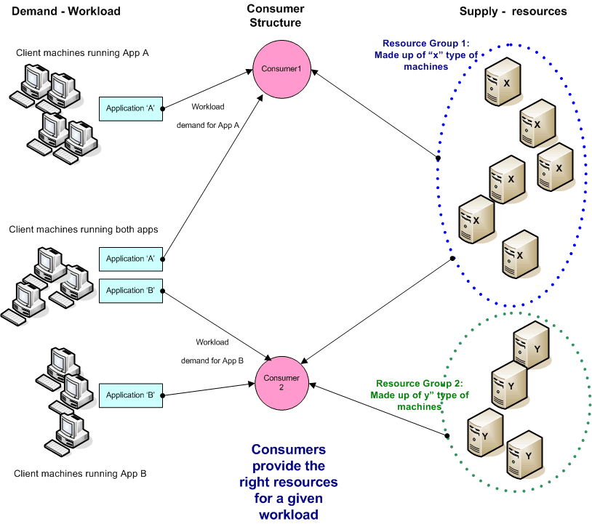
Resource/Consumer Architecture

Slide 12
Shared Resource Logic
Illustration of three shared-resource models
A combination of all three models can be managed within a single grid at the same time!

Slide 13
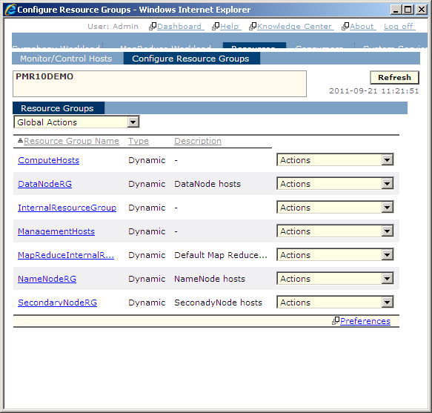
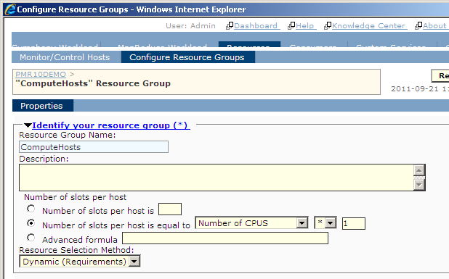
Resource Groups / Slot Allocation

Slide 14
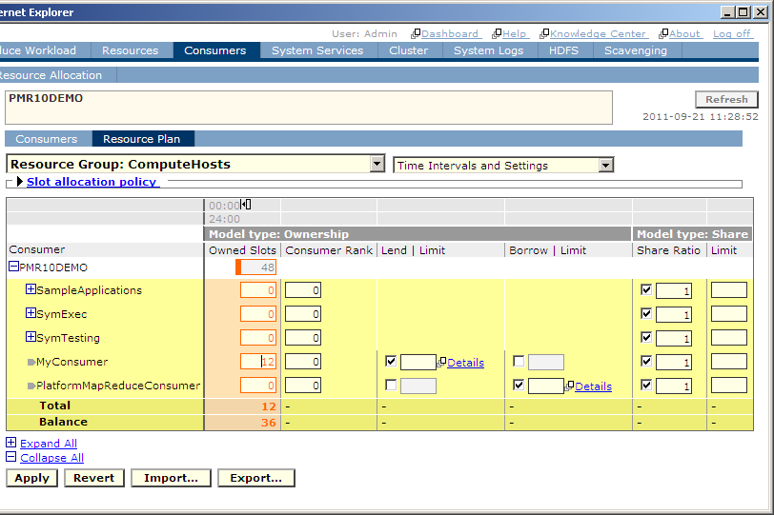
Consumer Allocation

Slide 15
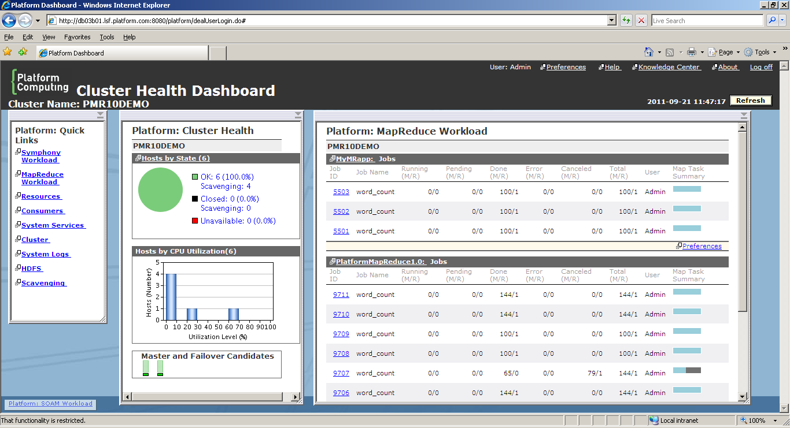
Multiple MapReduce Job Trackers
(Applications)
12 owned+36 shared equally
36 shared equally +12 borrowed

Slide 16

Shared Resources, Heterogeneous Application Support
Single Cluster/Grid – Single Management Interface
MapReduce
Application 1
Risk
Application
MapReduce
Application 2
CVA
Application
Job 1
Job 2
Job 1
Job 2
Job 1
Job 2
Job 1
Job 2
Job 3
Job N
Job 3
Job N
Job 3
Job N
Job 3
Job N
Application Mgr
Application Mgr
Application Mgr
Application Mgr
Instance/Task Mgr
Instance/Task Mgr
Instance/Task Mgr
Instance/Task Mgr
Platform Resource Orchestrator / Resource Monitoring
Resource 1
Resource 2
Resource 15
Resource 22
Resource 29
Resource 36
Resource 43
Resource 50
Resource 3
Resource 4
Resource 16
Resource 23
Resource 30
Resource 37
Resource 44
Resource 51
Resource 5
Resource 6
Resource 17
Resource 24
Resource 31
Resource 38
Resource 45
Resource 52
Resource 7
Resource 8
Resource 18
Resource 25
Resource 32
Resource 39
Resource 46
Resource 53
Resource 9
Resource 10
Resource 19
Resource 26
Resource 33
Resource 40
Resource 47
Resource 54
Resource 11
Resource 12
Resource 20
Resource 27
Resource 34
Resource 41
Resource 48
Resource 55
Resource 13
Resource 14
Resource 21
Resource 28
Resource 35
Resource 42
Resource 49
Resource N
Automated Resource Sharing

Slide 17
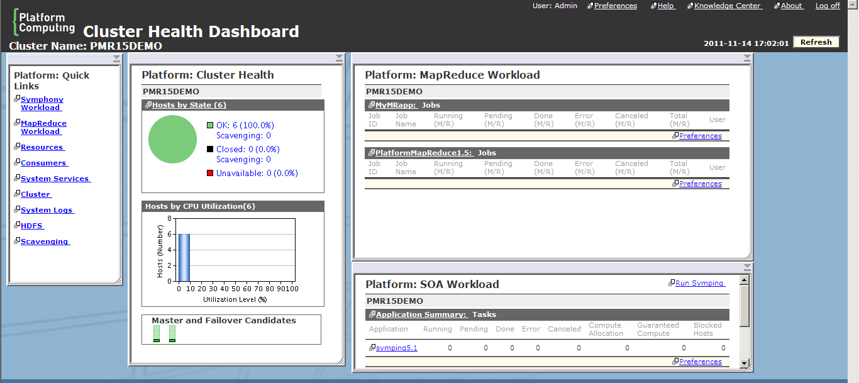
GUI Management Console

Slide 18
Performance
Extremely low latency architecture
Very fast workload allocation
Very small overhead to start jobs
Simultaneous job management
Two areas of significant performance improvement:
  Short-Run Jobs
    Low latency & immediate map allocation and job startup
  Sophisticated parallel workload management
    Improves total workload execution
    Reduces or eliminates wait time
    Drives workload predictability

Slide 19
Performance Comparison
Platform Symphony MapReduce versus Hadoop

Slide 20
High Availability
Platform Symphony MapReduce
Common Failover/Recovery Cases:
  Host running Job Tracker fails
  Job tracker automatically fails over and jobs recovered and continue.
  Host running Map Task fails
  Map Task automatically rescheduled on another host.
  Host running Reduce Task fails
  Reduce Task automatically rescheduled on another host.
  HDFS NameNode fails
  HDFS NameNode automatically fails over and jobs recovered and continue.

Slide 21
Thank You

Slide 22
Key Benefits Summary
Flexibility/Choice
  Compatible with Open Source & Commercial APIs
  Supports Open Source & Commercial File Systems
Reliability, Availability
  Guaranteed business continuity
  Enterprise –class operations
Scalability
  Extensive customer base
  20000+ cores/100’s simultaneous applications
High Resource Utilization
  Single pool of shared resources across applications
  Eliminates silos or single purpose clusters
Performance
  Low latency architecture
  Many jobs across many applications simultaneously
Manageability
  Ease of Management, monitoring, troubleshooting
Predictability
  Drives SLA based management

